Slide 1

Food Waste Management
European University of Bangladesh

Slide 2
Food Waste Management
Submitted by
Submitted to
Name | ID
Saiful Islam Rishad | 190122051
M Sazzad Sultani Roksi | 190122063
Rifatul Islam | 190122041
Tariqul Islam Rifat | 190122050
Most. Sima Akter | 190122015
Most. Tahmina Rahman Lecturer Department of CSE European University Of Bangladesh

Slide 3
Contents
Introduction
Motivation
Objectives
Features
Conclusion

Slide 4
Introduction
Food Waste Management is an online software system of donating food to the foodless people around the country.

Slide 5
Motivation
There are many foodless people around the country. They can hardly afford food for their family and themselves as well. So we took a step to reach food to those helpless people from the wasted food of restaurant, community centers and party centers.

Slide 6
Objective
Doners will post the food detail, pick location address, quantity of people available for donated food
Our agents will buy or take those foods from the pick address and reach to the foodless people

Slide 7
Features of the application
Doner End
Admin End
Signup/Login
View Profile
Edit Profile
About Us
Post food details
Signup/Login
View Profile
Edit Profile
About Us
View food posts
Buy/Collect foods from pick address

Slide 8
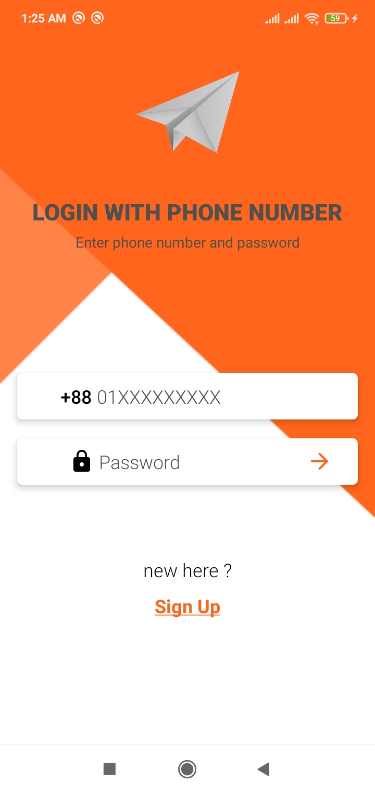
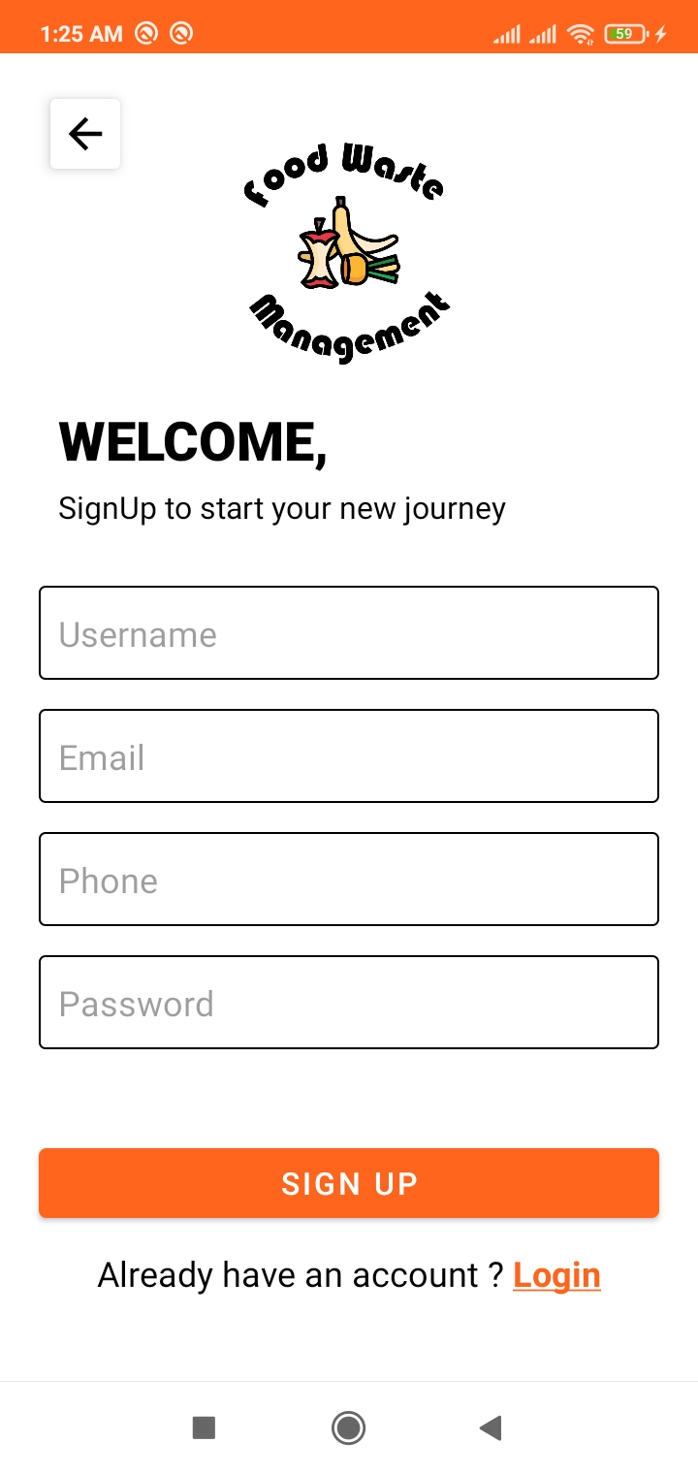
Features (Continued)
Figure: Login
Figure: Signup

Slide 9
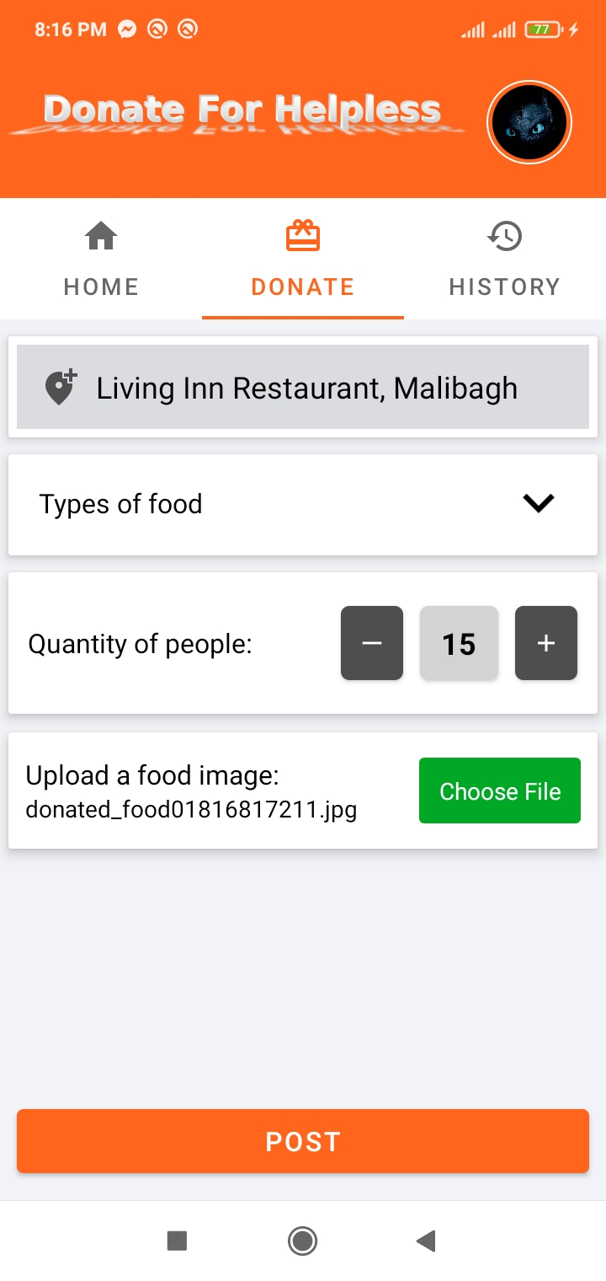
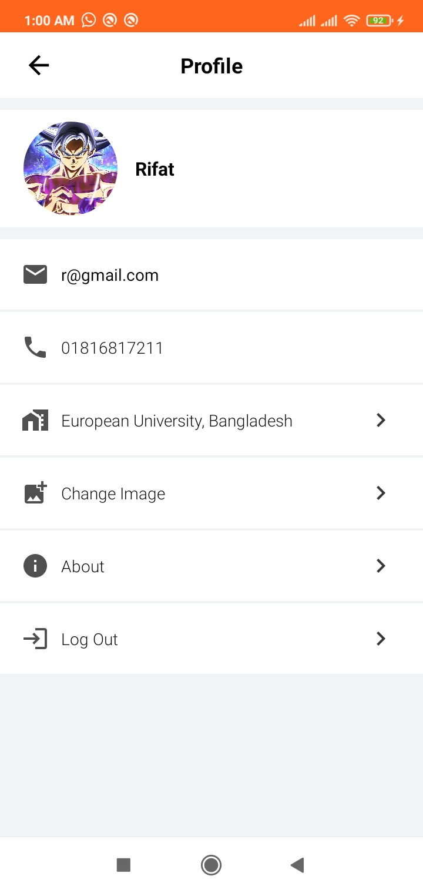
Features (Continued)
Figure: Donate Food
Figure: Profile

Slide 10
Conclusion
If we want to compete with the world, we have to improve our abilities and contribute to digitalize and improve our society. For this very reason, we chose to develop this project which will help a lot of people.

